Slide 1
Reactive Home Disaster Prevention System
Presented By: Waleed El Alawi, Preet Patel, Tiwaloluwa Ojo

Slide 2
Purpose and Requirement
The purpose of this project is to create a smart kitchen ventilation system.
Assists homeowners to turn on/off ventilation fan if the temperature increases.
System should be able to detect increase in temperature and humidity and turn on the ventilation fan.
The system should turn on the ventilation fan and notify the user if there’s increases or decreases in temperature or humidity are detected by the system.

Slide 3
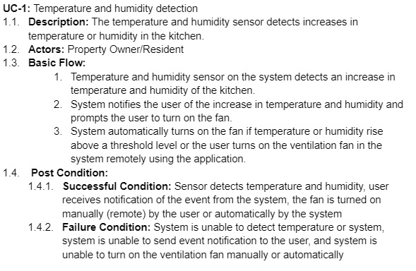
Use case

Slide 4
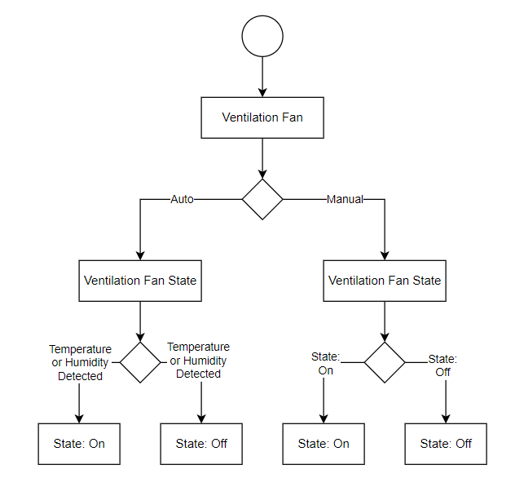
Design Architecture

Slide 5
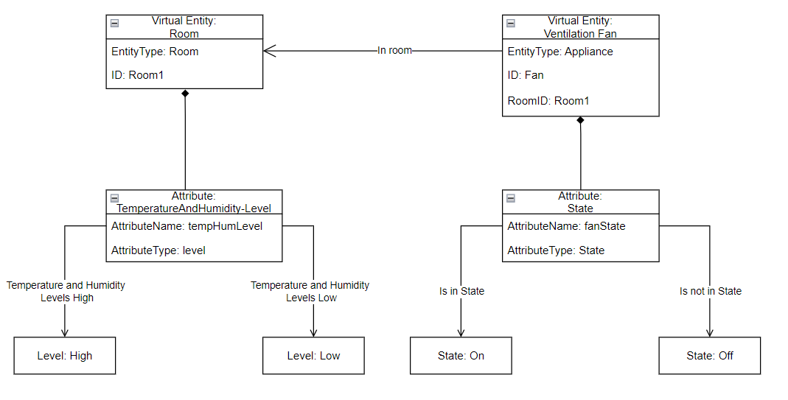
Design Architecture

Slide 6
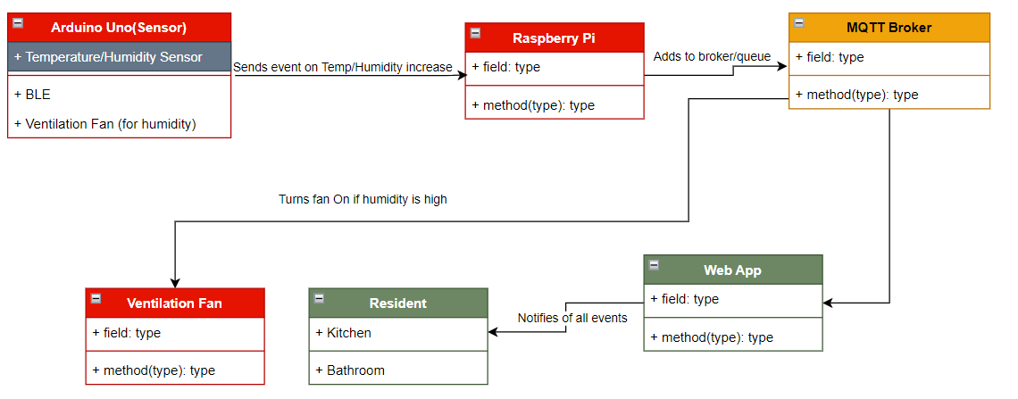
Design Architecture

Slide 7
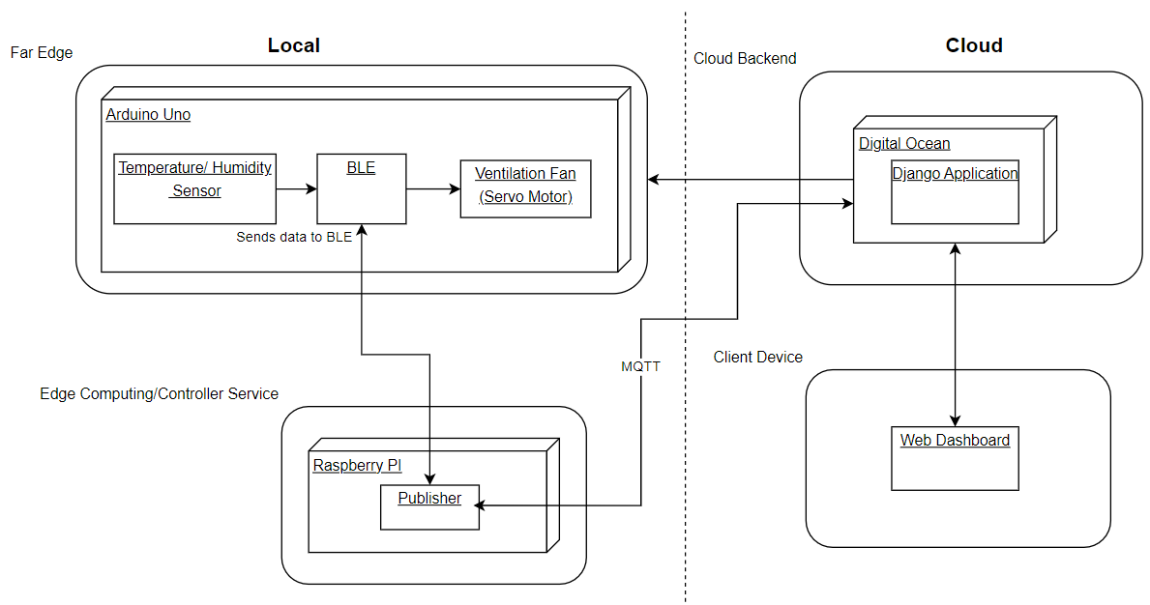
Design Architecture

Slide 8
Demo (Issues)

